Slide 1

LLOYD MAX IMPLEMENTATION ON KNOWN RANDOM DISTRIBUTED SOURCE
ELL712
Submitted by: Submitted to:
Dibyajyoti Jena Prof. Abhishek Dixit
2022EEE2712
Department of Electrical Engineering
INDIAN INSTITUTE OF TECHNOLOGY, Delhi

Slide 2
Objectives of the project:
Implementation of Lloyd Max algorithm for different input distributions, such as Gaussian, Rayleigh and Uniform.
Since Lloyd Max may not always be optimal, implement the same process using stochastic gradient descent.
INDIAN INSTITUTE OF TECHNOLOGY, Delhi

Slide 3
Quantization Problem:
For an input of known distribution f(u), there are two subproblems at hand: finding representation points a[j] and finding region boundaries b[j].
For a given set of representation points, the region boundaries lie midway between them. No knowledge of distribution required here.
For a given set of region boundaries, we need the input distribution to determine what the representation points will be.
A representation point a[j] will be given by the conditional expectation of the input pdf f(u) bounded by its region boundaries b[j] and b[j+1].
INDIAN INSTITUTE OF TECHNOLOGY, Delhi

Slide 4


f(u)
Fig 1: pdf of input signal
b[j] a[j] b[j+1] a[j+1]
As shown in figure, boundary point
Representation point:
Where Q(u) is probability that input u belongs to region b[j] to b[j+1].
INDIAN INSTITUTE OF TECHNOLOGY, Delhi

Slide 5

Lloyd Max quantization process:
Lloyd Max algorithm is an iterative process that implements the above logic to minimize MSE (Mean Squared Error).
Set arbitrary representation points (random or uniform does not matter practically).
Find out boundary from consecutive representation points.
Find out new representation points by taking conditional mean of the pdf.
Find MSE, given by avg of sum of squares of errors.
Repeat steps 2 and 3 until there is no decrement in MSE.
u = input, a = representation point
M = input batch size
INDIAN INSTITUTE OF TECHNOLOGY, Delhi

Slide 6

Lloyd Max is implemented for Gaussian, Rayleigh and Uniform input pdfs. However it must be noted that Lloyd Max is not the most optimal valley finding algorithm, it may end up with a local minima of MSE instead of global minima. Thus we also try Stochastic Gradient Descent on these pdfs.
Stochastic Gradient Descent:
Random input points are chosen and compared with representation points to find out MSE.
New representation points are given by the following formula: (rest of the process remains same)
Gradient refers to partial fraction of mse with a[j]
refers to learning rate. Learning rate may be fixed or variable (described in code report).
INDIAN INSTITUTE OF TECHNOLOGY, Delhi

Slide 7
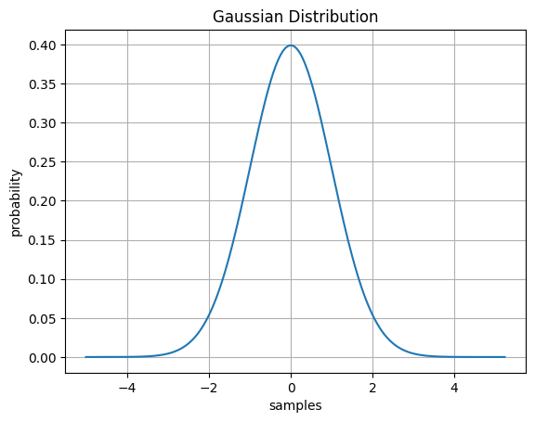
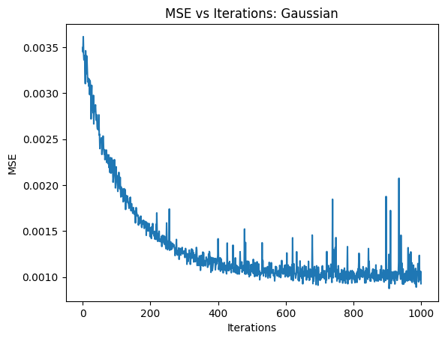
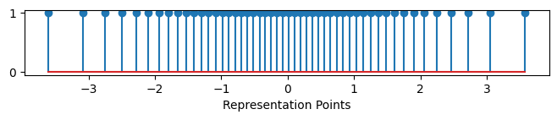
Lloyd Max results: Gaussian
Fig 2: Probability distribution Fig 3: MSE vs Iterations
Fig 4: Optimal representation points
INDIAN INSTITUTE OF TECHNOLOGY, Delhi

Slide 8
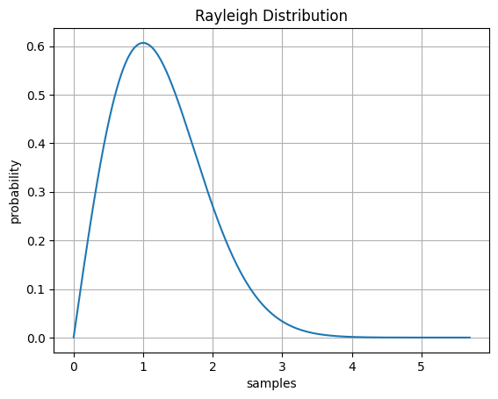
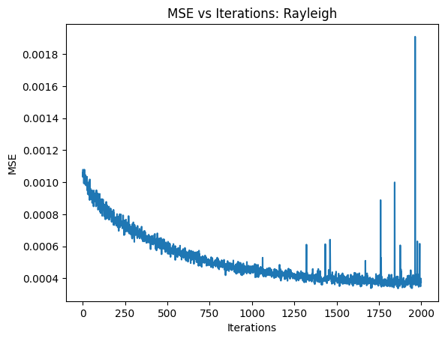
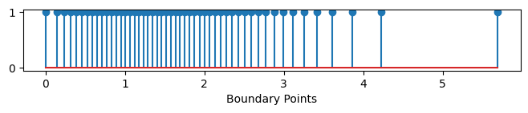
Lloyd Max results: Rayleigh
Fig 5: Probability distribution Fig 6: MSE vs Iterations
Fig 7: Optimal boundary points
INDIAN INSTITUTE OF TECHNOLOGY, Delhi

Slide 9
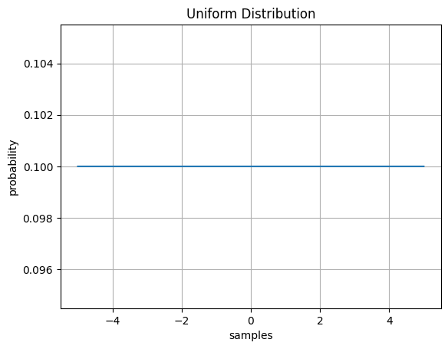
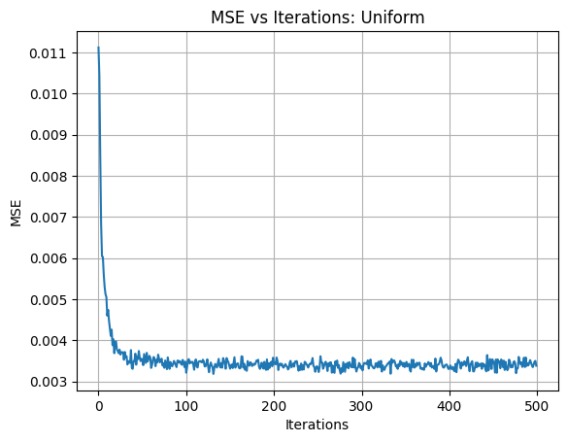
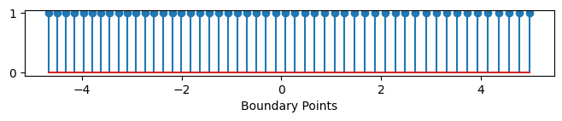
Lloyd Max results: Uniform
Fig 8: Probability distribution Fig 9: MSE vs Iterations
Fig 10: Optimal boundary points
INDIAN INSTITUTE OF TECHNOLOGY, Delhi

Slide 10
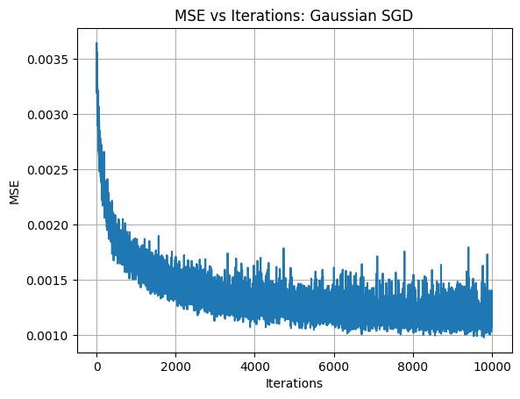
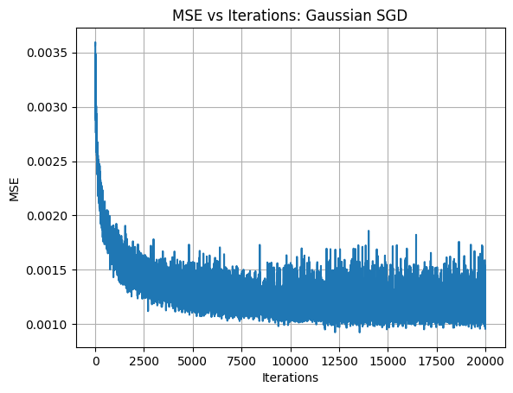
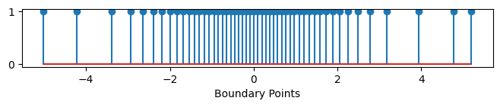
Gradient Descent results: Gaussian
Fig 11: MSE vs Iterations Fig 12: Optimal boundary points along the
distribution
INDIAN INSTITUTE OF TECHNOLOGY, Delhi

Slide 11
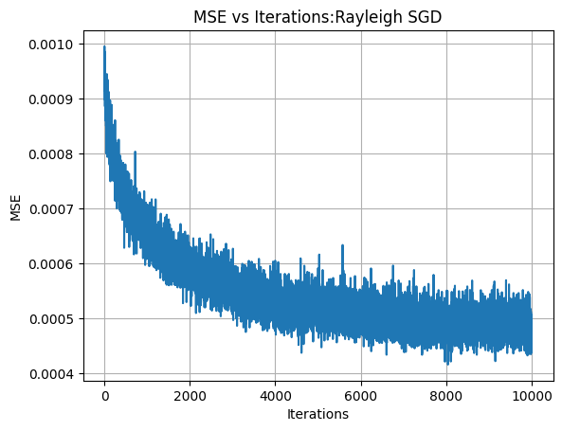
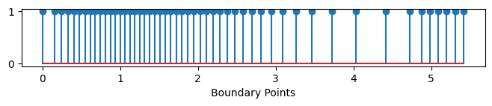
Gradient Descent results: Rayleigh
Fig 13: MSE vs Iterations Fig 14: Optimal boundary points along the
distribution
INDIAN INSTITUTE OF TECHNOLOGY, Delhi

Slide 12
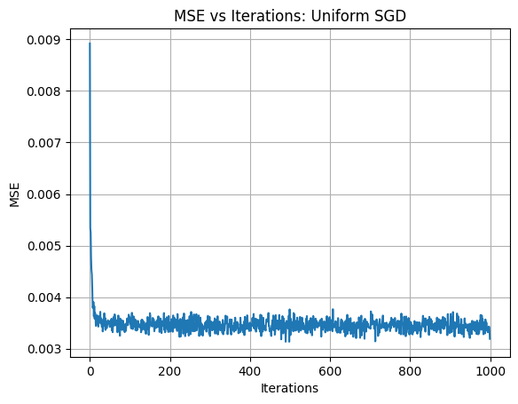
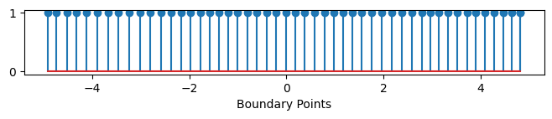
Gradient Descent results: Uniform
Fig 15: MSE vs Iterations Fig 16: Optimal boundary points along the
distribution
INDIAN INSTITUTE OF TECHNOLOGY, Delhi

Slide 13
Inference from the experiment:
From the above results, we see that stochastic gradient descent performed equally well as did Lloyd Max.
To be noted: Stochastic Gradient Descent requires no prior knowledge of the pdf while Lloyd Max is dependent on the input pdf to calculate representation points. This makes SGD advantageous when pdf of input is unknown.
More plot wise results are attached in code report.
INDIAN INSTITUTE OF TECHNOLOGY, Delhi

Slide 14
References:
Robert Gallager, course materials for 6.450 Principles of Digital Communications I, Fall 2006. MIT OpenCourseWare(http://ocw.mit.edu/), Massachusetts Institute of Technology.
https://numpy.org/doc/stable/
https://docs.scipy.org/doc/numpy-1.15.0/reference/generated/numpy.random.random.html
INDIAN INSTITUTE OF TECHNOLOGY, Delhi

